Slide 1
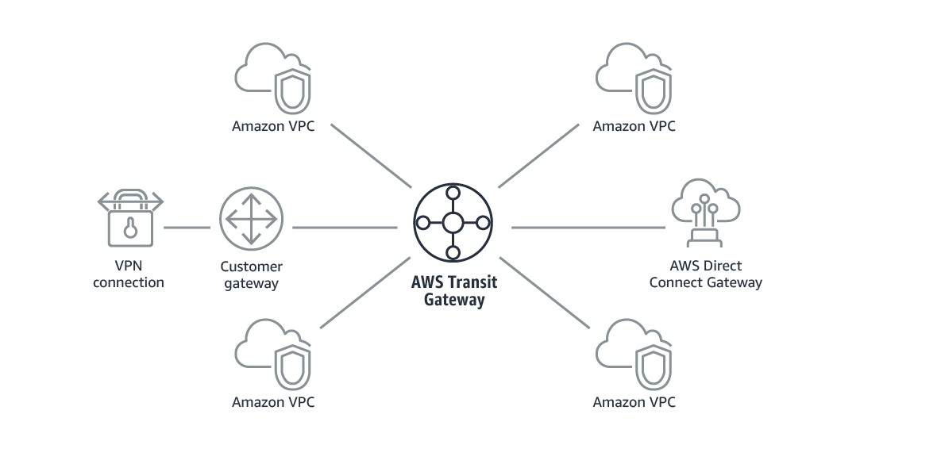
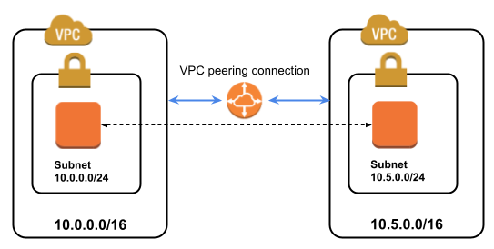
VPC Peering or Transit Gateway?
OR

Slide 2
A VPC peering connection helps you to facilitate the transfer of data privately between two peered VPC.

Slide 3
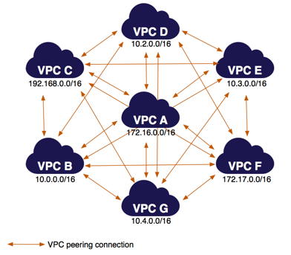
Multiple VPC Peered together: You can use this full mesh configuration when you have multiple VPC Peered.

Slide 4

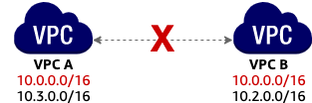
VPC Peering limitation: Overlapping CIDR blocks: You cannot create a VPC peering connection between VPCs with matching or overlapping IPv4 CIDR blocks. If the VPCs have multiple IPv4 CIDR blocks, you cannot create a VPC peering connection if any of the CIDR blocks overlap. This limitation also applies to VPCs that have non-overlapping IPv6 CIDR blocks.

Slide 5
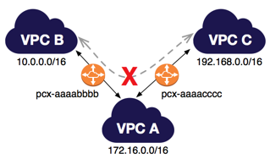
Transitive peering
If there is no VPC peering connection between VPC B and VPC C. You cannot route packets directly from VPC B to VPC C through VPC A.

Slide 6
What is AWS transit gateway?
AWS Transit Gateway connects your Amazon Virtual Private Clouds (VPCs) and on-premises networks through a central hub. This connection simplifies your network and puts an end to complex peering relationships.

Slide 7
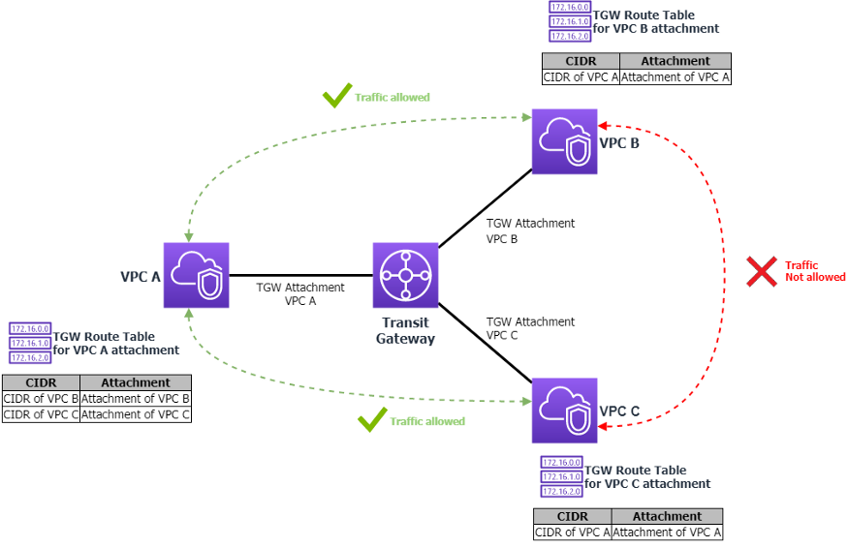
Here’s how the Transit Gateway Route Tables would look:

